Slide 1
Rationale
Introducing C# and the .NET Framework," provides an overview of the .NET Framework and shows how you can start to build your own .NET Framework applications by using C# and Visual Studio 2012

Slide 2
Topics
Introduction to .Net Framework
Components of Framework
Compilation and Execution of .Net Applications
Different Types of Compilers
Assemblies and its details
Different Language support in .Net Framework
Introduction to Visual Studio 2012
Sample Program and Disassembler

Slide 3
What is .Net Framework
The .NET Framework provides a comprehensive development platform that offers a fast and efficient way for designing, developing, deploying applications and services.
Using Visual Studio, developers can utilize the .NET Framework to create a wide range of solutions that operate across a broad range of computing devices.
It is the core of the .NET infrastructure because it exists as a layer between the .NET applications and the underlying operating system.

Slide 4




Components of .Net Architecture
Common Language Runtime
Base Class Libraries
Development Frameworks

Slide 5
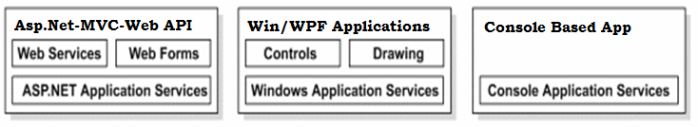
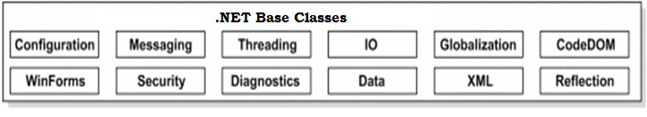
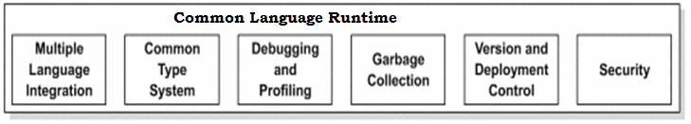
Components of .Net Architecture
At the presentation layer,/Development Framework .NET provides different types of user interfaces.
The .NET Framework class library works with any .NET language, such as VB.NET, VC++ , and VC#.
The .NET Framework class library comprises namespaces, which are contained within assemblies.
CLR is the environment in which all programs that use .NET technologies are executed.
The CLR allows the execution of code across different platforms by translating code into Intermediate Language (IL).
Notes:
Using this slide, discuss with the students that .NET Framework consists of 3 different components. Discuss each of the components one by one. Try to give an example of the components.

Slide 6
Execution Model
C# Code
VB.NET Code
C# Compiler-Native Compiler
VB.NET Compiler-Native Compiler
Intermediate Language-MSIL
Single Deployable Unit
IL+MetaData(Manifest )
.Exe,.dll
Common Language Runtime
JIT Compiler
Native Code

Slide 7
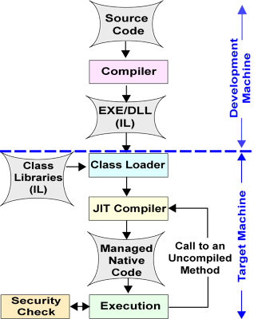
Compilation and Execution

Slide 8





How the Common Language Runtime Loads, Compiles, and Runs Assemblies
Assemblies contain MSIL code, which is not actually executable
The CLR loads the MSIL code from an assembly and converts it into the machine code that the computer requires
Loads assemblies that the application references
1
Verifies and compiles assemblies into machine code
2
Runs the executable assembly
3
Notes:
Explain the following :
The Class Loader locates and loads all assemblies that the application requires.
The Microsoft intermediate language (MSIL)-to-native compiler verifies the MSIL code and compiles all assemblies into machine code ready for execution.
The Code Manager loads the executable assembly and runs the Main method.
The Garbage Collector provides automatic lifetime memory management of all objects that your application creates. The Garbage Collector disposes of any objects that your application is no longer using.
The Exception Manager provides structured exception handling for .NET applications, which is integrated with Windows Structured Exception Handling.
Question: What steps does the CLR perform when you run your application?
Answer: The CLR performs the following steps:
The Class Loader locates and loads all assemblies that the application requires. The assemblies will already be compiled into MSIL.
The MSIL-to-native compiler verifies the MSIL code and then compiles all assemblies into machine code ready for execution.
The Code Manager loads the executable assembly and runs the Main method.

Slide 9





What Is an Assembly?
Building blocks of .NET Framework applications
Assembly is a single deployable unit that contains all the information about the implementation of classes, structures, and interfaces.
MyAssembly .dll OR .exe
Assembly signed with a digital certificate
MyClassA
MyResource
MyClassB
V 1.1.254.1
Assembly version
<major>.<minor>.<build>.<revision>
Notes:
Explain what an assembly is, mentioning that assemblies form the fundamental unit of deployment, version control, reuse, activation scoping, and security permissions.
Explain that an assembly can be either a .dll or an .exe file.
Explain that you should version any assemblies that you distribute. Explain that versioning information can help you identify which versions customers already have and enable you to perform the necessary steps to upgrade the application.
Explain that as well as versioning you should also sign your assemblies. Explain that signing ensures that your assemblies cannot easily be modified or replaced by an alternative implementation from a malicious source.
Question: Why would you choose to distribute an assembly rather than distribute the source code?
Answer: An assembly is a compiled unit that can contain multiple functional components that is ready to run. If you distributed raw source files, end users would have to compile the code before they could run the application.

Slide 10
Compiling MSIL to Native Code
Before you can run Microsoft intermediate language (MSIL), it must be compiled against the common language runtime to native code for the target machine architecture. The .NET Framework provides two ways to perform this conversion:
A .NET Framework just-in-time (JIT) compiler.
The .NET Framework Native Image Generator (Ngen.exe).
JIT Compiler:
JIT compilation converts MSIL to native code on demand at application run time, when the contents of an assembly are loaded and executed.

Slide 11
Types of JIT compilers
1. Pre-JIT:-
Pre-JIT complies complete source code into native code in a single compilation cycle. This is done at the time of deployment.
2. Econo-JIT:-
Econo-JIT complies only those methods that are called at runtime. However, these complied methods are removed when they are not required.
3. Normal-JIT:-
Normal-JIT complies only those methods that are called at runtime. These methods are complied the first time they are called, and then they are stored in cache. When the same methods are called again, the complied code from cache is used for execution.

Slide 12
Framework Class Library-FCL
The .NET Framework class library works with any .NET language, such as VB.NET, VC++ .NET, and VC#.
The .NET Framework class library provides classes, Interfaces that can be used in the code to accomplish a range of common programming tasks, such as string management, data collection, database connectivity, and file access.
Mscorlib.dll-It’s a Dynamic Link Library, which is shared assembly, which consists of the very important base class libraries of .Net framework.
C:/ Windows/ Microsoft.NET/ Framework/ (version number)/ mscorlib.dll.

Slide 13
FCL
The .NET Framework class library comprises of:
Namespaces
Assemblies
Namespaces: Logical Collection of classes
System. Data, System.XML
System. Object is the ultimate base class of all classes in the .NET Framework; it is the root of the type hierarchy
Assemblies: Physical collection

Slide 14
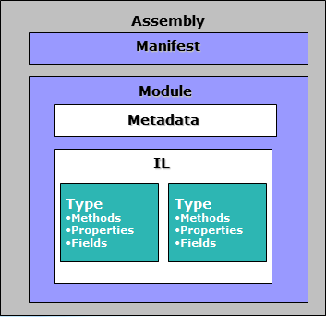
Anatomy of .Net Applications

Slide 15
Just a Minute
1. _________ compiles MSIL code in to native code.
a. JIT Compiler
b. MSIL Compiler
c. Language Compiler
d. Microsoft .NET Compiler

Slide 16
Just a Minute
1. _________ compiles MSIL code in to native code.
a. JIT Compiler
b. MSIL Compiler
c. Language Compiler
d. Microsoft .NET Compiler

Slide 17
Advantages of .NET Frameworks
Consistent programming model
Multi-platform applications
Multi-language integration
Automatic resource management
Ease of deployment

Slide 18
Evolution of .Net Framework
Overview of .NET Framework release history
Generation | Version number | Release date | Development tool | Distributed with
1.0 | 1.0.3705.0 | 13 February 2002 | Visual Studio .NET | N/A
1.1 | 1.1.4322.573 | 24 April 2003 | Visual Studio .NET 2003 | Windows Server 2003
2.0 | 2.0.50727.42 | 7 November 2005 | Visual Studio 2005 | Windows Server 2003 R2
3.0 | 3.0.4506.30 | 6 November 2006 | Expression Blend | Windows Vista, Windows Server 2008
3.5 | 3.5.21022.8 | 19 November 2007 | Visual Studio 2008 | Windows 7, Windows Server 2008 R2
4.0 | 4.0.30319.1 | 12 April 2010 | Visual Studio 2010 | N/A
4.5 | 4.5.50709.17929 | 15 August 2012 | Visual Studio 2012 | Windows 8, Windows Server 2012

Slide 19
What's New in the .NET Framework Version 3.0
WPF(Windows Presentation Foundation)
Provides the ability to build rich, interactive client applications
WCF(Windows Communication Foundation)
Provides a common programming model for building services and connecting applications
CardSpace
Provides a safer and more secure alternative to username and password authentication
WF (Windows Work Flow )
Provides the ability to define declarative, long-running workflows

Slide 20
What's New in the .NET Framework Version 3.5
.NET Compact Framework
LINQ-Language Integrated Query
Asp.net with AJAX
Change in CLR
Expression Trees -for LINQ
and many more..

Slide 21
What's New in the .NET Framework Version 4.0
The Dynamic Language Runtime
Managed Extensibility Framework
Optional parameters
Named Parameters
Co-variance and Contra-variance
and many more..

Slide 22
What's New in the .NET Framework Version 4.5
.NET for Windows Apps Store
Portable class library
Parallel Computing
HTML5 Support
Async and Await
Caller information
and many more..

Slide 23
Languages
Languages provided by Microsoft
VB, C++, C#, F#, Jscript, TypeScript
Third-parties are building
APL, COBOL, Pascal, Eiffel, Haskell, ML, Oberon, Perl, Python, PHP, Ruby, Scheme, Smalltalk…

Slide 24
Just a Minute
1. Out of the following languages which language doesn't have a built in support in .Net Framework
a. C#
b. Java
c. F#
d. Vb.Net

Slide 25
Just a Minute
1. Out of the following languages which language doesn't have a built in support in .Net Framework
a. C#
b. Java
c. F#
d. Vb.Net

Slide 26
Key Features of Visual Studio 2012
Visual Studio 2012:
Intuitive IDE that enables developers to quickly build applications in their chosen programming language
Visual Studio 2012 features:
Rapid application development
Server and data access
Debugging features
Error handling
Help and documentation
Notes:
Briefly explain that Visual Studio provides the following features:
Intuitive integrated development environment (IDE).
Rapid application development with Designer and Code Editor windows, and wizards.
Server and data access with the Server Explorer window.
Debugging features.
Error handling.
Help and documentation, including Microsoft IntelliSense® and code snippets.
If time permits, show students Visual Studio 2010.
Question: What are the main reasons why you may choose Visual Studio 2010 over a text editor such as Notepad++?
Answer: Answers should include:
The intuitive IDE in Visual Studio 2010.
Visual Studio 2010 supports rapid application development with Designer and Code Editor windows, and wizards.
Visual Studio 2010 provides debugging features that help you fix any bugs in your code.
Visual Studio 2010 offers help and support with IntelliSense, code snippets, and the Visual Studio community.

Slide 27












Templates in Visual Studio 2012
Console Application
WPF Application
Class Library
Windows Forms Application
ASP.NET Web Application
ASP.NET MVC Application
Silverlight Application
WCF Service Application
Notes:
Briefly explain each of the templates highlighted on the slide, explaining their purpose and when you may want to use them.
Question: What project templates would you use for each of the following:
A client application that will run on a Windows-based computer.
A library of functionality that you want to use in other applications.
A Web site that you will host on an Internet Information Services (IIS) Web server.
Answer: Possible answers include:
For a client application, you could use the WPF Application and Windows Forms Application templates.
For a library, you could use the Class Library template.
For a Web site, you could use the ASP.NET Web Application and ASP.NET MVC 2 Application templates.

Slide 28
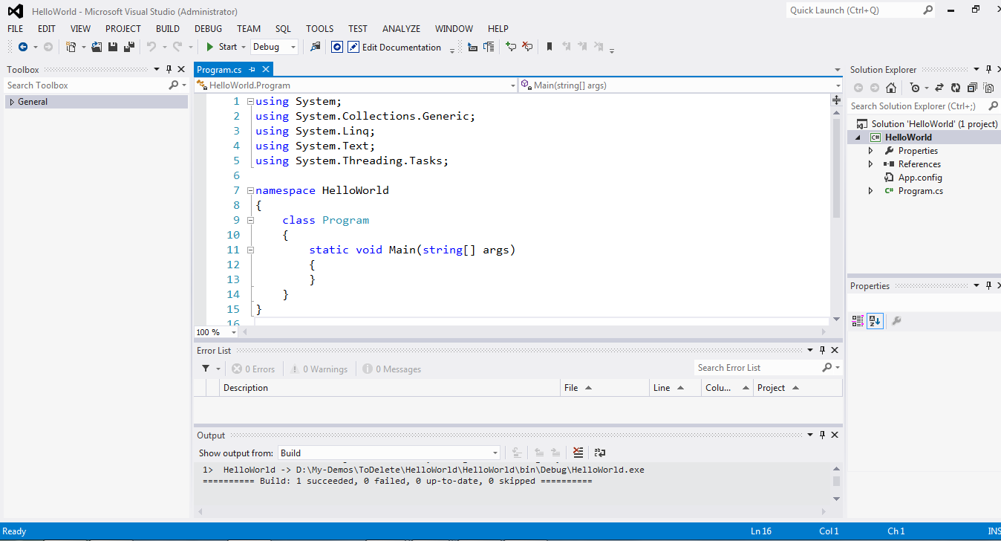
Windows in Visual Studio 2012
Menu Bar
Tool Box
Solution Explorer
Code Editor
Properties Window
Error List
Output Window

Slide 29


The Structure of Visual Studio Projects and Solutions
Visual Studio Solution
Visual Studio solutions are wrappers for .NET projects
Visual Studio solutions can contain multiple .NET projects
Visual Studio solutions can contain different types of .NET projects
ASP.NET project
WPF project
.aspx
.csproj
.xaml
.csproj
.aspx.cs
.config
.xaml.cs
.config
Console project
.cs
.csproj
.config
Notes:
Explain that Visual Studio 2012 uses solutions and projects as conceptual containers to organize your source files during development.
Explain that a project is used to organize source files, references, and project-level configuration settings that make up a single .NET Framework application or library.
Explain that a project typically includes .cs .csproj .aspx .config and .xaml files.
Explain that a single Visual Studio solution is a container for one or more projects.
Explain that a solution typically contains .sln and .suo files.
If time permits, open Visual Studio and show students how to add and remove projects from a solution by using the Solution Explorer window.
Question: What role does the .sln file play in Visual Studio solutions?
Answer: .NET solutions act as a wrapper for solution settings and your .NET projects. .NET solutions also enable you to build multiple projects without having to open multiple instances of Visual Studio.

Slide 30
Creating a .NET Framework Application
1
Open Visual Studio 2012
2
On the File menu, click New, and then click Project
3
In the New Project dialog box, specify the following, and then click OK:
- Project template
- Project name
- Project save path
Programmer productivity features include:
IntelliSense
Code snippets.
Refer: https://msdn.microsoft.com/en-us/library/z41h7fat.aspx
Notes:
Explain the steps on the slide and show students the New Project dialog box in Visual Studio 2010.
Explain and demonstrate IntelliSense and code snippets.
Question: What is the purpose of code snippets?
Answer: Code snippets remove the need for developers to repeatedly type common code constructs.

Slide 31

Building and Running a .NET Framework Application
Visual Studio
1
In Visual Studio 2012, on the Build menu, click Build Solution
2
On the Debug menu, click Start Debugging
Command line
csc.exe "C:\Users\Student\Documents\Visual Studio 2012\MyProject\*.cs“
csc.exe " C:\Users\Student\Documents\Visual Studio 2012\MyProject\myApplication.exe"
Notes:
Explain that you can build and run an application in Visual Studio.
Show students both the Build menu and Debug menu in Visual Studio.
Explain that you can also build your application on the command line by using csc.exe.
Explain the contents of the command using the example on the slide.
/t:<type of assembly>
/out:<path and name of output assembly>
The last parameter being the location of the source files you want to compile.
Question: Describe two ways to build and run a .NET Framework application.
Answer: You can build a .NET application by using Visual Studio or csc.exe on the command line.

Slide 32
First Program-Hello World
public class Hello
{
public static void Main(string[] args)
{
System.Console.WriteLine("Hello, World! \n");
}
}

Slide 33
First Program-Hello World
The class keyword:Is used to declare a class.
public class Hello
{
public static void Main(string[] args)
{
System.Console.WriteLine("Hello, World! \n");
}
}

Slide 34
First Program-Hello World
public class Hello
{
public static void Main(string[] args)
{
System.Console.WriteLine("Hello, World! \n");
}
}
The Main() Function:Is the entry point of an application.
.

Slide 35
First Program-Hello World
public class Hello
{
public static void Main(string[] args)
{
System.Console.WriteLine("Hello, World! \n");
}
}
System.Console.WriteLine():
Displays the enclosed text on the user’s screen
.

Slide 36
First Program-Hello World
public class Hello
{
public static void Main(string[] args)
{
System.Console.WriteLine("Hello, World! \n");
}
}
The Escape character:
Displays new line character. Other special characters can also be displayed, such as \t, \b and \r.

Slide 37
Disassembling a .NET Framework Assembly
ILDASM-Intermediate Language Disassembler
The Ildasm.exe parses any .NET Framework .exe or .dll assembly, and shows the information in human-readable format.
Ildasm.exe shows more than just the Microsoft intermediate language (MSIL) code — it also displays namespaces and types, including their interfaces.
You can use Ildasm.exe to examine native .NET Framework assemblies, such as Mscorlib.dll, as well as .NET Framework assemblies provided by others or created yourself.
Notes:
In this demonstration, you will see how to use Ildasm.exe to disassemble a .NET assembly.
Demonstration Steps
Task 1: Run an existing .NET application
Right-click the Start menu, and then click Open Windows Explorer.
In Windows Explorer, move to the E:\Demofiles\Mod1\Demo1 folder, and then double-click MyFirstApplication.exe.
In the MyFirstApplication window, point out:
The title of the Command Prompt window, which is set to My First Application.
The text Hello, this is my first .NET application which is displayed in the Command Prompt window.
That the Command Prompt window does not automatically close until you click the X icon on the toolbar.
Close the MyFirstApplication window.
Task 2: Open Ildasm
Right-click the Start menu, and then click Open Windows Explorer.
In Windows Explorer, move to the C:\Program Files\Microsoft SDKs\Windows\v7.0A\bin folder, and then double-click ildasm.exe.
Task 3: Disassemble an existing .NET Framework assembly
In the Il Dasm window, on the File menu, click Open.
In the Open dialog box, move to the E:\Demofiles\Mod1\Demo1 folder, and then double-click MyFirstApplication.exe.

Slide 38
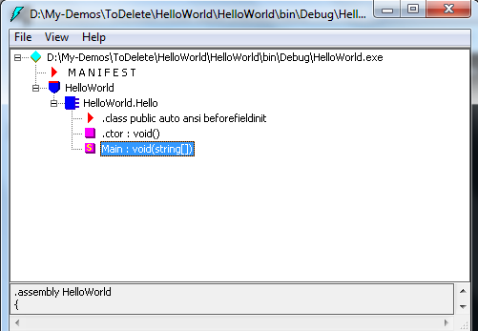
Demonstration:

Slide 39
Just a Minute
State True or False:
ILDASM can be used do disassemble only .dll files
a. True
b. False

Slide 40
Just a Minute
State True or False:
ILDASM can be used do disassemble only .dll files
a. True
b. False

Slide 41
Summary
In this session we have covered
What is .Net framework and compilation process with different types of JIT Compilers.
What is Assembly and its Anatomy using ILDASM.
What is Visual Studio IDE and different project templates used in VS2012.
Sample “Hello World” Program.

